Slide 1



Slide 2


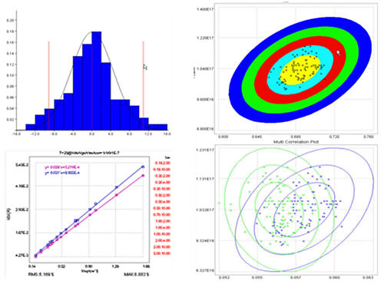



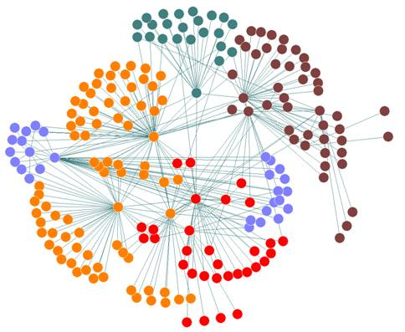

+
+
+

Slide 3
PROJECTS WORKED
CLIENT TITLE SEGMENTATION
SPECIALIST LOCI
CLIENT DISENGAGEMENT

Slide 4
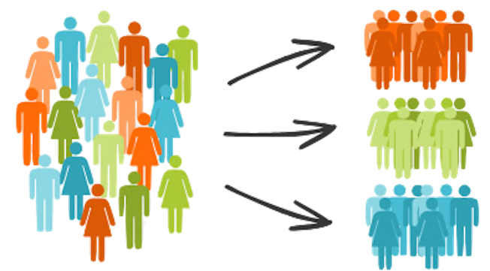
CLIENT TITLE SEGMENTATION

Slide 5
Misspelt Words
e.g: Manger, Adminitrator
Synonyms
e.g: Coordinator, planner, on-site
Abbreviations
e.g: AM, PM, SVP
Reused Keywords
e.g: Executive Chef, Chief Executive Officer
CHALLENGES

Slide 6
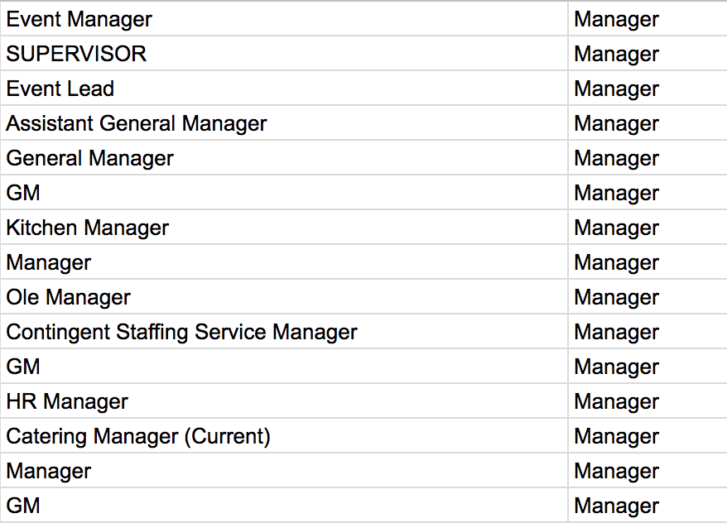
APPROACH AND RESULTS
Collaboration with Marketing Team
Pre-built Python library for spelling correction + Eyeball
Strategic Mapping
Hierarchical Sorting
CSV files of Client Title Segments

Slide 7
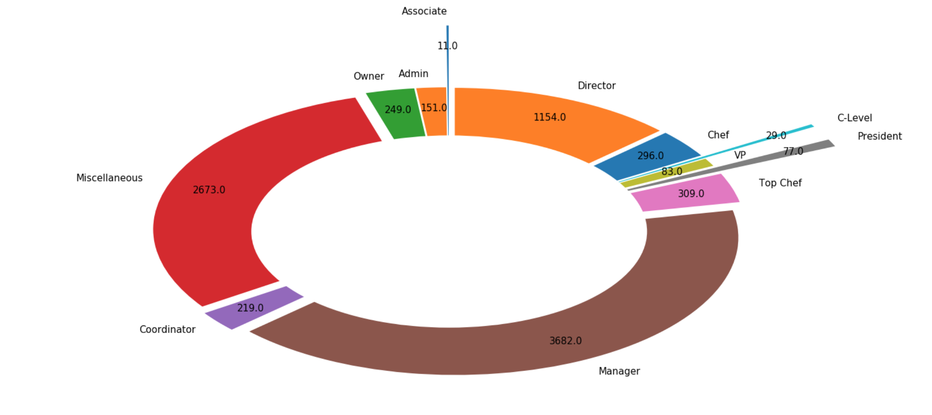
COUNT OF CLIENT USERS IN EACH INFERRED TITLE GROUP

Slide 8
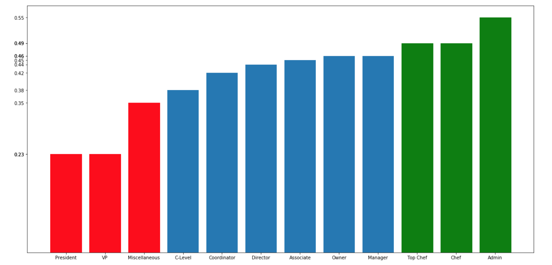
% OF CLIENT USERS IN EACH TITLE GROUP WITH A SUBMITTED OUTCOME
INFERRED CLIENT TITLES

Slide 9
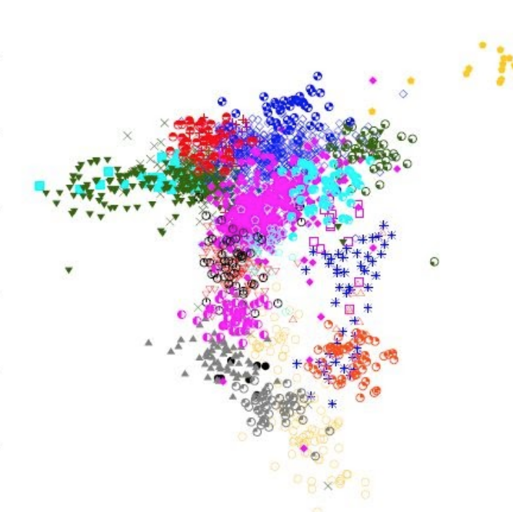
SPECIALIST LOCI

Slide 10

CLUSTER ANALYSIS
- geographic proxy
k=3
Market = Chicago

Slide 11
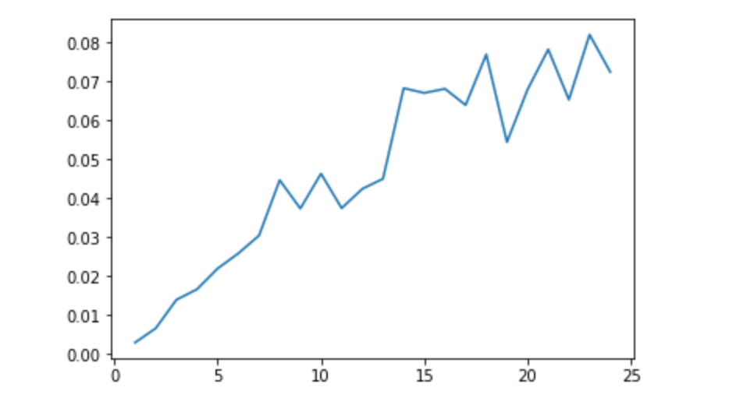
ABSTRACTION V/S GRANULARITY
BEST NUMBER OF CLUSTERS
13
R-squared
Number of clusters

Slide 12
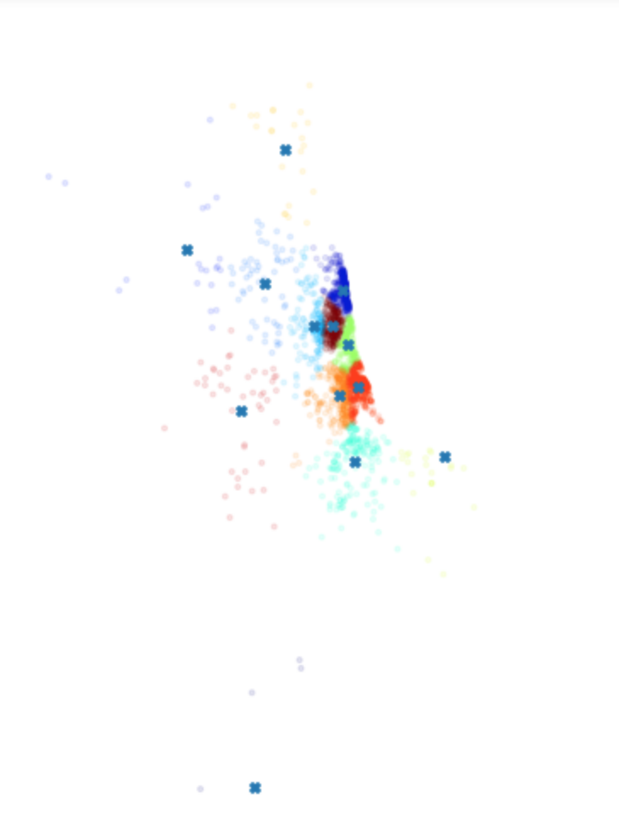
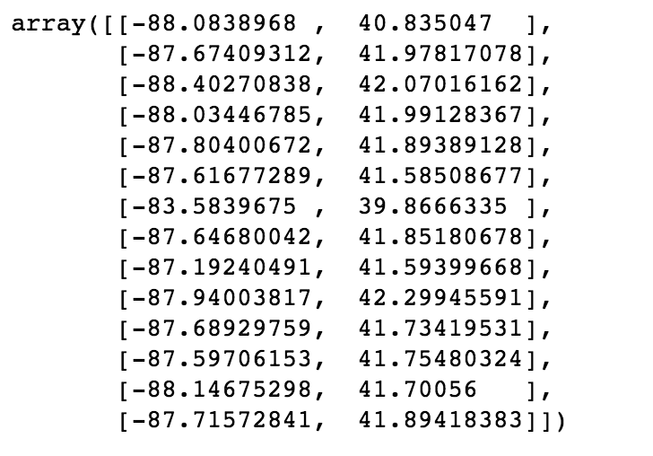
RESULTS
CLUSTER CENTROIDS FOR MARKET OF CHICAGO

Slide 13

CLIENT DISENGAGEMENT

Slide 14
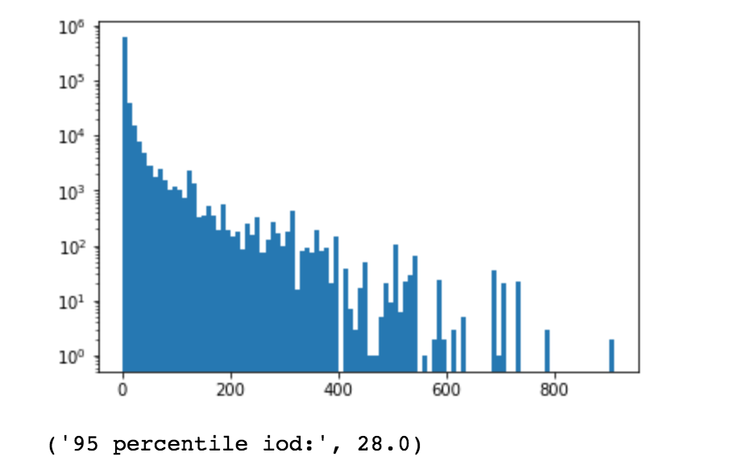
DEFINITION OF DISENGAGEMENT
How long to wait?
95% significance
Disengaged and Disengaging

Slide 15
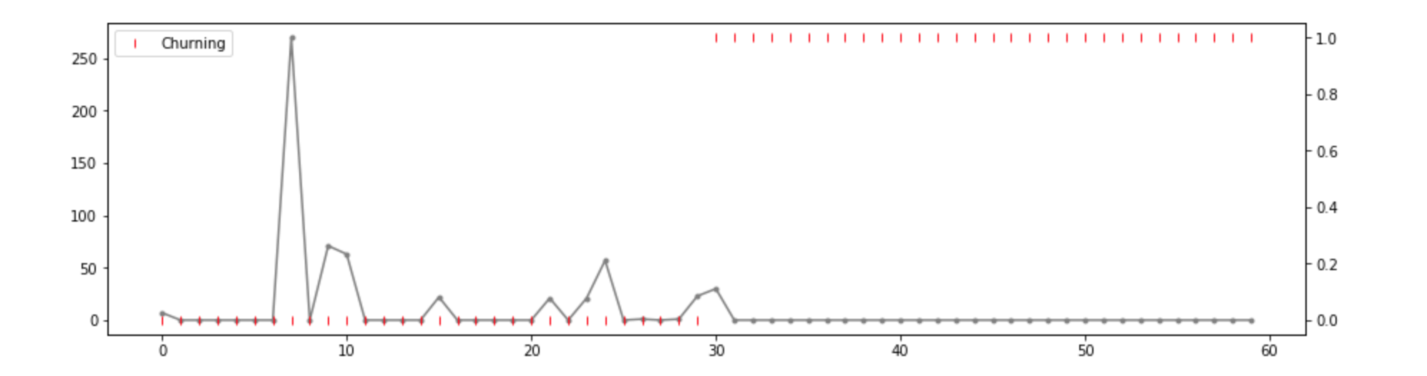
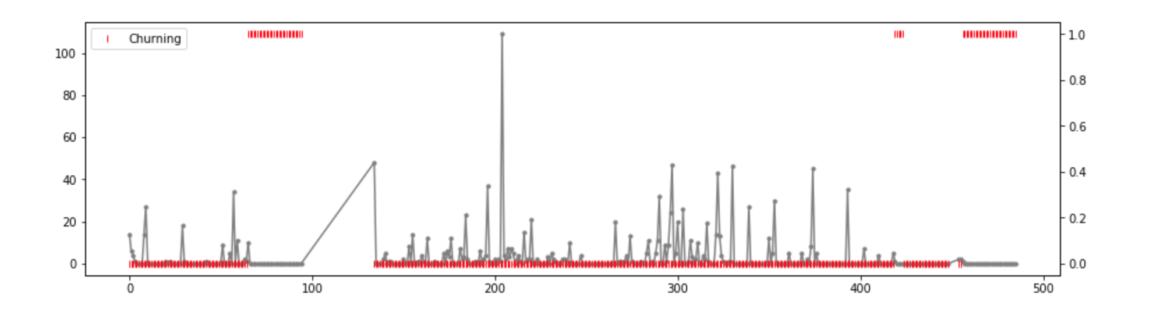
BEHAVIOUR OF CLIENTS
| Disengaging
Target
Disengaging
(0 or 1)
Num_shifts
Numdays_between
| Disengaging
Num_shifts
Target
Disengaging
(0 or 1)
Numdays_between

Slide 16
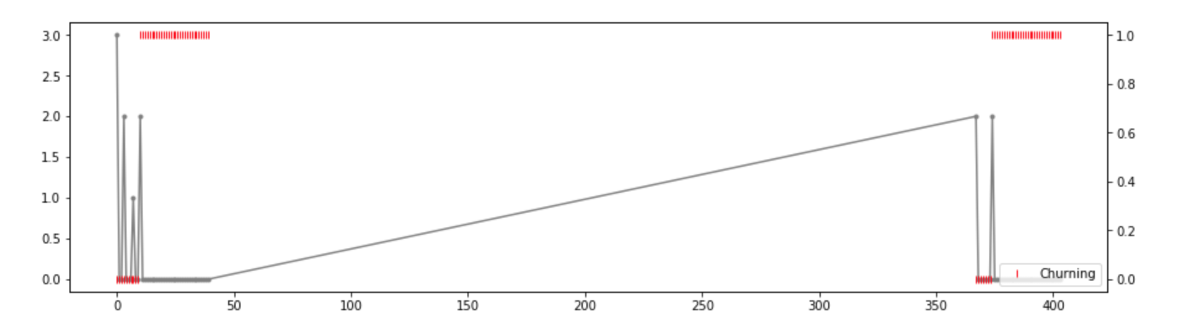
BEHAVIOUR OF CLIENTS
Num_shifts
Target
Disengaging
(0 or 1)
| Disengaging
Numdays_between

Slide 17
FEATURES USED FOR MODELING
rolling_labor_hours
rolling_approx_bill
rolling_approx_pay
Rolling_crowfiles_average
Is_reconciled_needed_primary
Num_shifts
Sum_allstared
Rolling_shift_adv_data
Last7_orders
Last30_orders
Rolling_company_succes

Slide 18
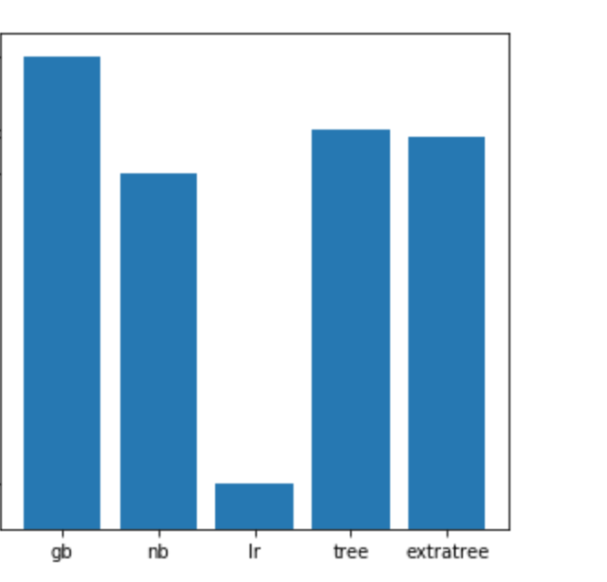

Naïve Bayes
Logistic Regression
Decision Trees
Extra Trees Classifier
Gradient Boosted
F2 SCORE
MODEL BUILDING

Slide 19
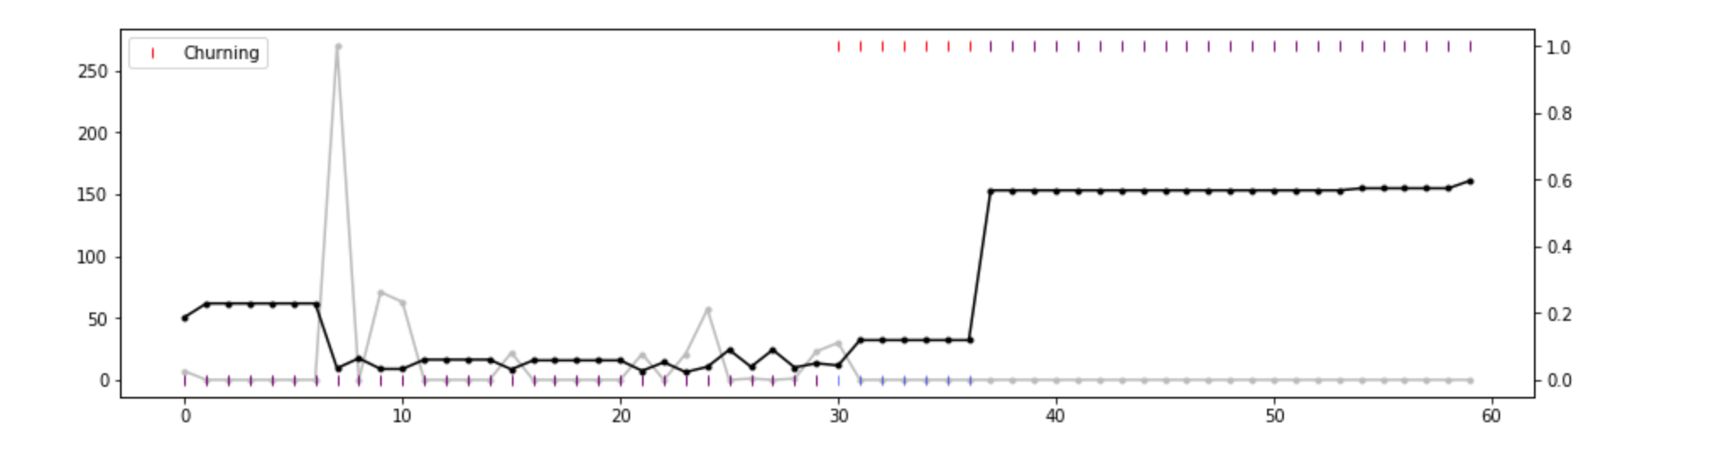
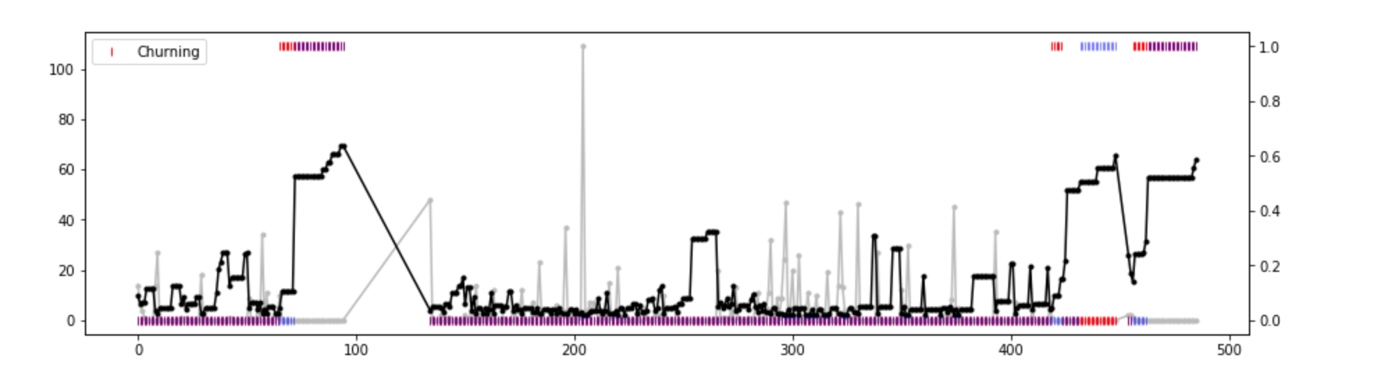
MODELING BEHAVIOUR OF CLIENTS
| Disengaging
Target
Disengaging
(0 or 1)
Num_shifts
Numdays_between
| Disengaging
Num_shifts
Target
Disengaging
(0 or 1)
Numdays_between

Slide 20
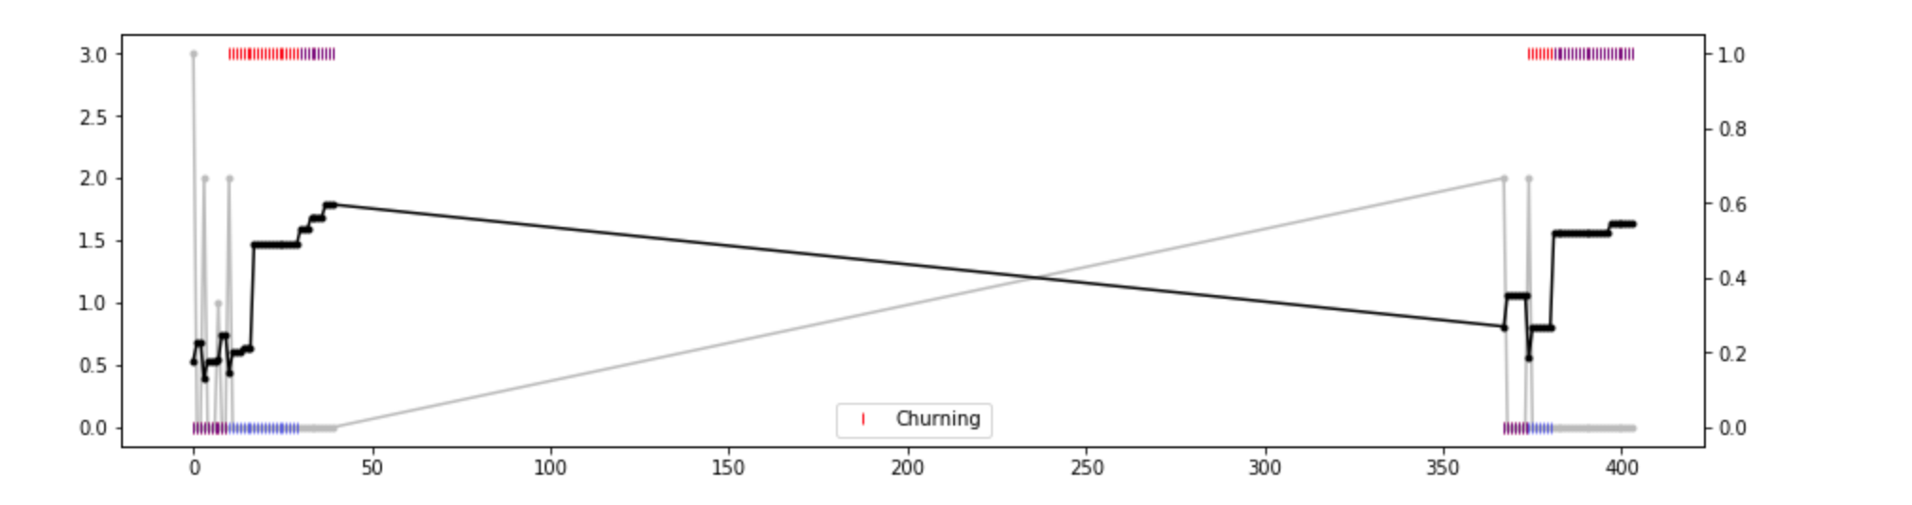
MODELING BEHAVIOUR OF CLIENTS
Target
Disengaging
(0 or 1)
Num_shifts
Numdays_between
| Disengaging

Slide 21
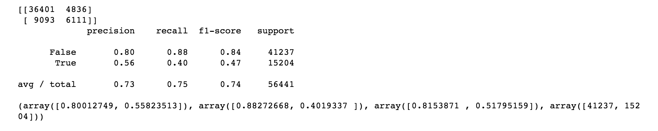
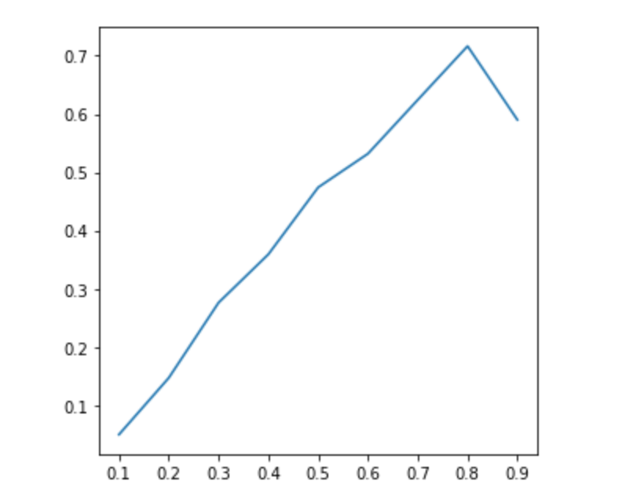
MODEL EVALUATION
REDUCE UNCERTAINITY
BY
10%
PREDICTED
PROBABILITIES
ACTUAL PROBABILITIES

Slide 22
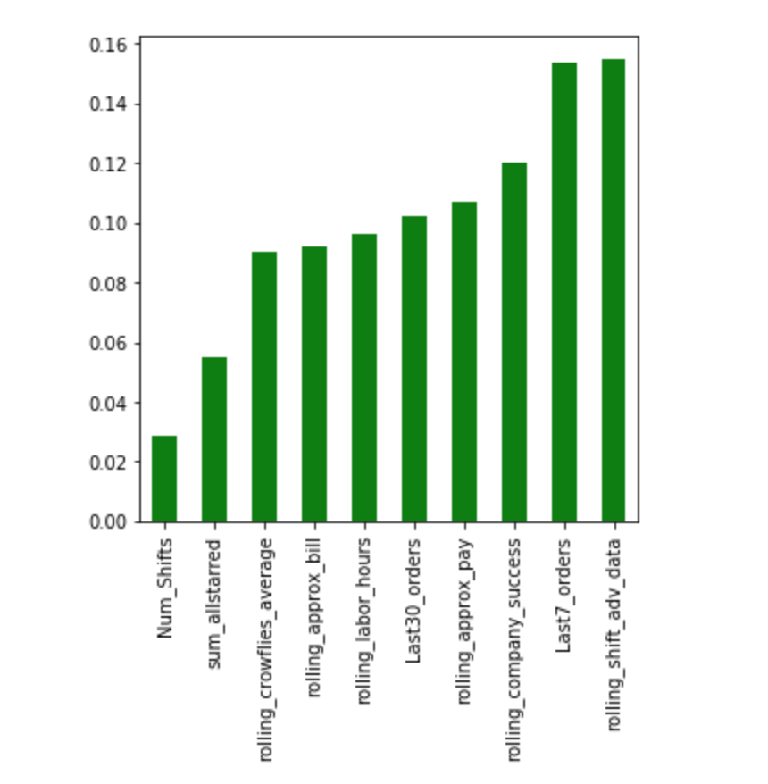
FEATURE
IMPORTANCE FOR
BEST MODEL

Slide 23
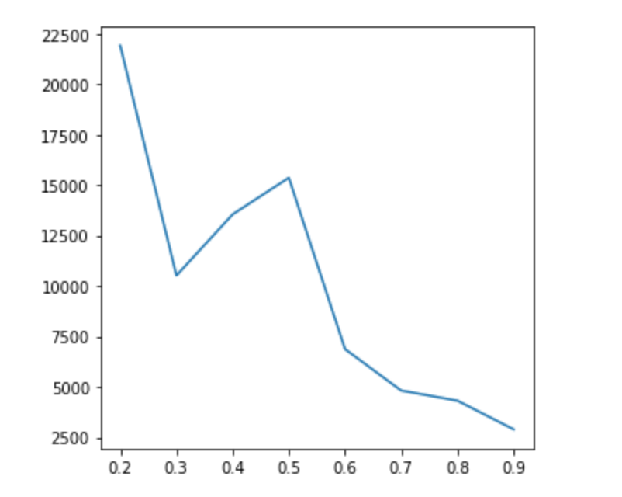
FEATURES USED FOR DECIDING IMPACT
Past60_profit
PROFIT
MODEL ESTIMATE OF PROBABLITY OF DISENGAGEMENT

Slide 24
FUTURE ROADMAP
Maintaining and optimizing client disengagement model
Extend to specialist disengagement
Use the client disengagement model to power an automated retention messaging campaign
Develop a model to directly assess how messaging impacts retention
Build a similar model that predicts profit directly
Developing a client reengagement model
A RNN model that tracks behaviors in the app to predict a client placing orders
A RNN model that tracks behaviors in the app to predict a specialist picking up a shift

Slide 25
WHO?
WHEN?

Slide 26


